Slide 1
Programming Fundamentals
By
Shazmeen Batool

Slide 2
Previous Lecture
Two way if else Statements
Common Errors in Control Statements

Slide 3
Today’s Lecture
Multi-way if else
Nested if else
Logical Operators

Slide 4
Multi-way if else (if else-if)
In C++, "if-else if" is a way to check multiple conditions one after another.
It's like a decision tree: you ask "Is this true?" If yes, do something. If not, check the next question ("else if"), and so on.
Finally, an "else" catches anything that doesn't match. This is great for handling different scenarios based on ranges, comparisons, or logic

Slide 5
Why use it?
Handles complex conditions like "greater than 90" or "equal to this AND that.“
Runs only the first matching block—stops checking once it finds a match.

Slide 6
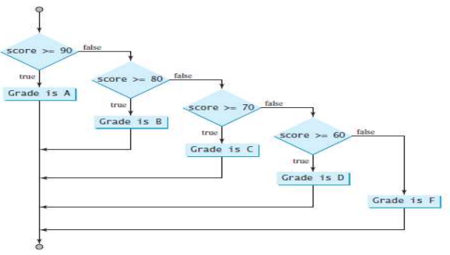
Multiple-way if

Slide 7
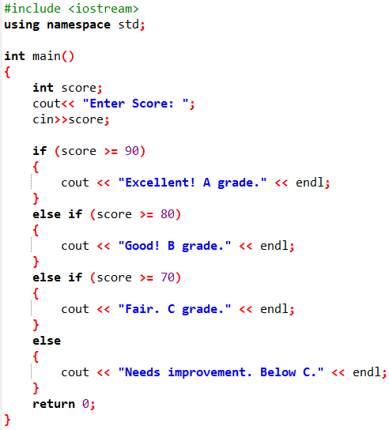


Example

Slide 8
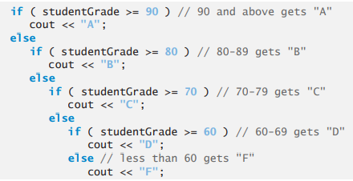
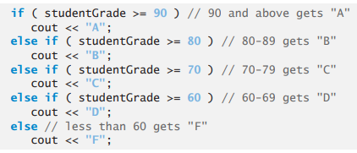
Multi-way if else (if else-if)
More than two possibilities, for example your grade in programming fundamentals course.
Equivalent
This is better

Slide 9
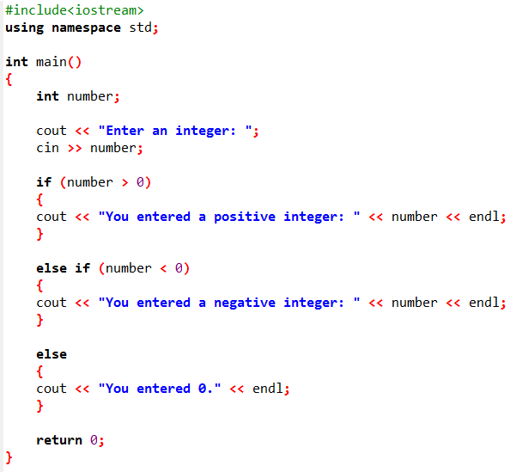
Program to check whether an integer is positive, negative or zero

Slide 10
Task: Chinese Zodiac Year using Multiple-way if
Now let us write a program to determine the Chinese Zodiac sign for a given year. The Chinese Zodiac is based on a twelve-year cycle, each year being represented by an animal: rat, ox, tiger, rabbit, dragon, snake, horse, sheep, monkey, rooster, dog, and pig, in this cycle, as shown in Figure 3.6 (next slide).
Note that year % 12 determines the Zodiac sign. 1900 is the year of the rat since 1900 % 12 is 4. Write a program that prompts the user to enter a year and displays the animal for the year.

Slide 11
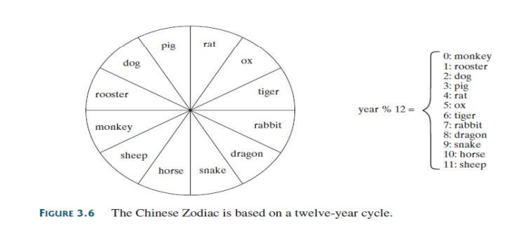
Task: Chinese Zodiac Year using if-else-if

Slide 12
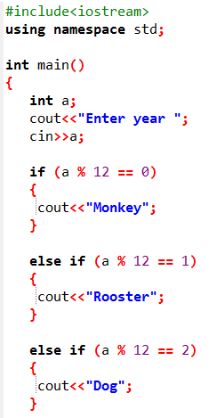
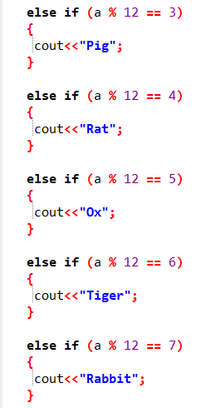
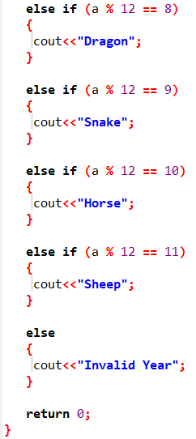

Slide 13
Nested if
An if statement can be inside another if statement to form a nested if statement.
Task: Write a code using nested if in which user enter three numbers, and find if 1st number is greater or not.

Slide 14
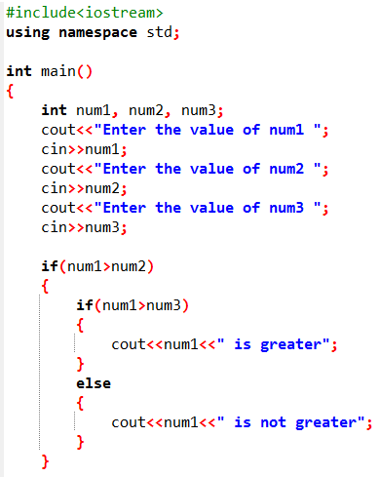


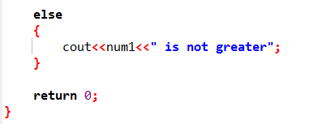
Output 1:
Output 2:

Slide 15
Logical Operators
The logical operators !, &&, and || can be used to create a compound Boolean expression.
Operator | Name | Description | Example
&& | Logical and | Returns true if both statements are true | x < 5 && x < 10
|| | Logical or | Returns true if one of the statements is true | x < 5 || x < 4
! | Logical not | Reverse the result, returns false if the result is true | !(x < 5 && x < 10)

Slide 16


Tasks
Write a Boolean expression that evaluates to true if age is greater than 13 and less than 18.
Write a Boolean expression that evaluates to true if weight is greater than 50 pounds or height is greater than 60 inches.
Write a Boolean expression that evaluates to true if weight is greater than 50 pounds and height is greater than 60 inches.

Slide 17
Tasks
Write a Boolean expression that evaluates to true if either weight is greater than 50 pounds or height is greater than 60 inches, but not both.

Slide 18
Task
Write a program that checks whether a number is divisible by 2 and 3, by 2 or 3, and by 2 or 3 but not both.

Slide 19
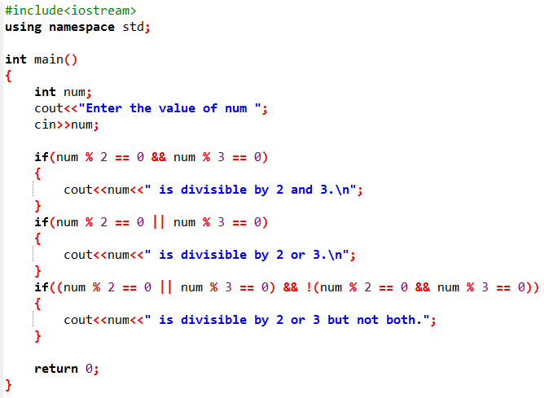


Output 1:
Output 2:

